Slide 1

Product Success Analysis
Gayathri adhimoolam

Slide 2
Road Map
Business Understanding
Data Understanding
Data Preparation
Modelling
Evaluation
Conclusion and Future Work

Slide 3
Business Understanding
Goal
- To identify (early) signals of success of the product.
Problem statement
- Using the given data, understand the reasons behind the success (or failure) of a product, and the indicators behind a successful product.

Slide 4
Data understanding
Data | Description
AMZ_sales | Contains sales performance measures (e.g., Quantity, Promotion Discount).
AMZ_prod | Contains information about the categories of the products.
AMZ_review | Contains review information of the product such as Rating, Sales Rank, etc.
AMZ_stock | Contains stock availability information of products.
AMZ_mktg | Contains information about the amount spent on ads and the results generated from the ads such as the Clicks, Impressions, etc.

Slide 5
Data Preprocessing
AMZ_Sales
A new feature “item_price_avg” was generated. It contains the average price of a product.
The raw data contains null values for quantity and item_price. These are filled using a mathematical approach and the feature generated.
AMZ_Prod
Some of the products have no categories specified. Therefore, they are all assigned to the category “other“.
Some sold products, missing in this dataset, are also added into the table as with their category value set to “other”.

Slide 6
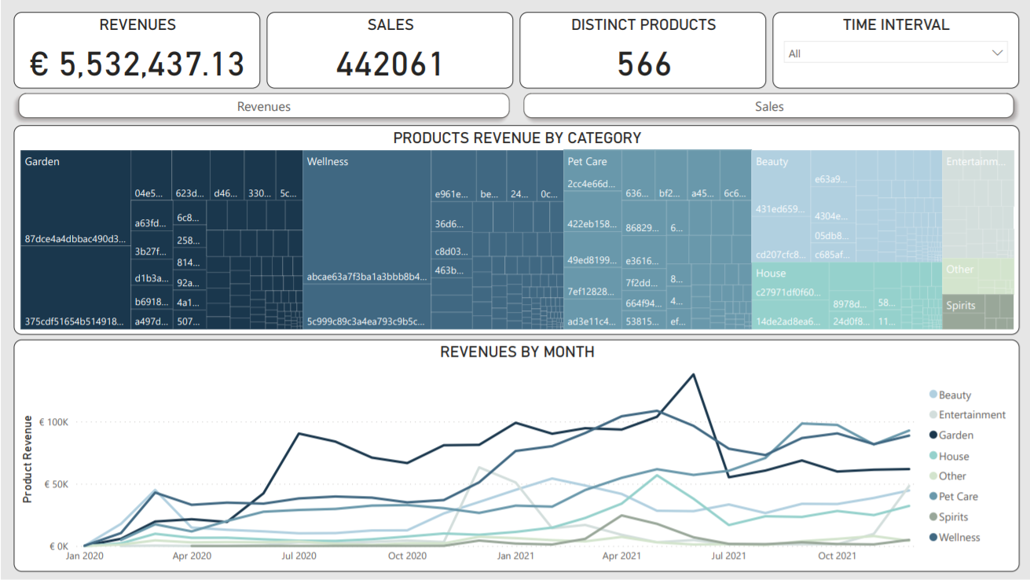
Data Analysis using Power BI Revenue and Sales overview

Slide 7
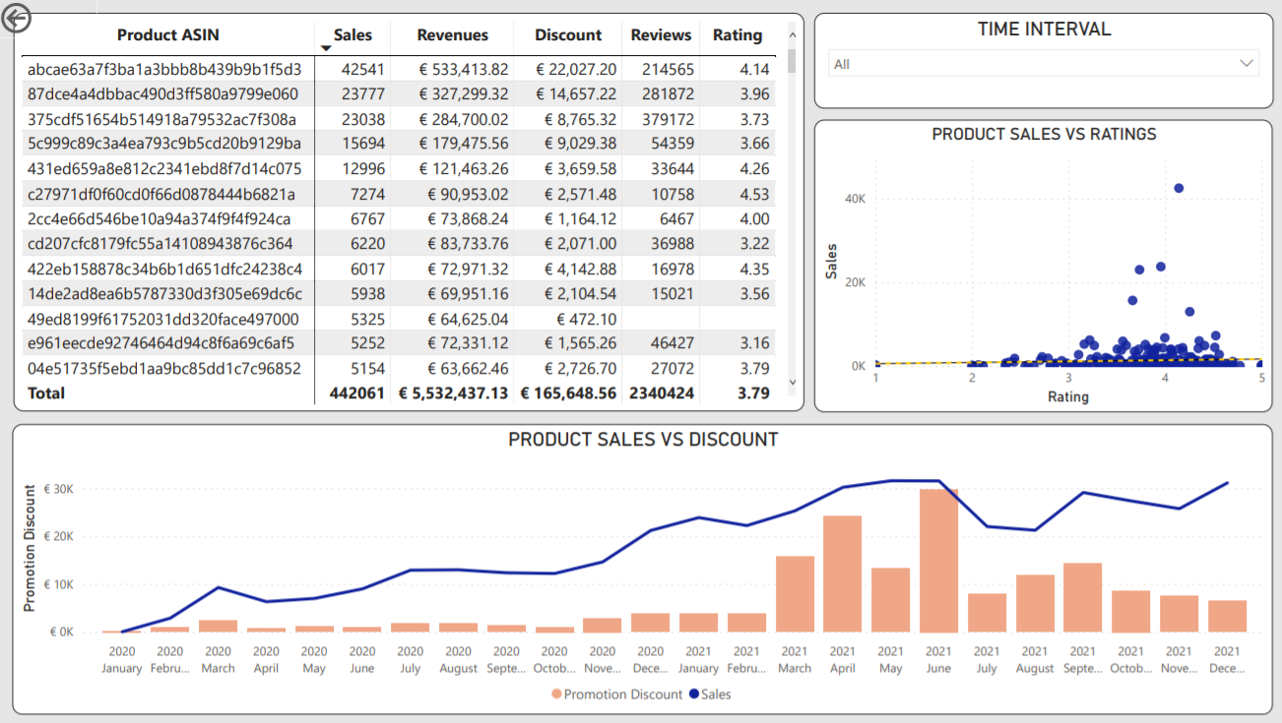
Data Analysis using Power BI Product Ratings and Discounts

Slide 8
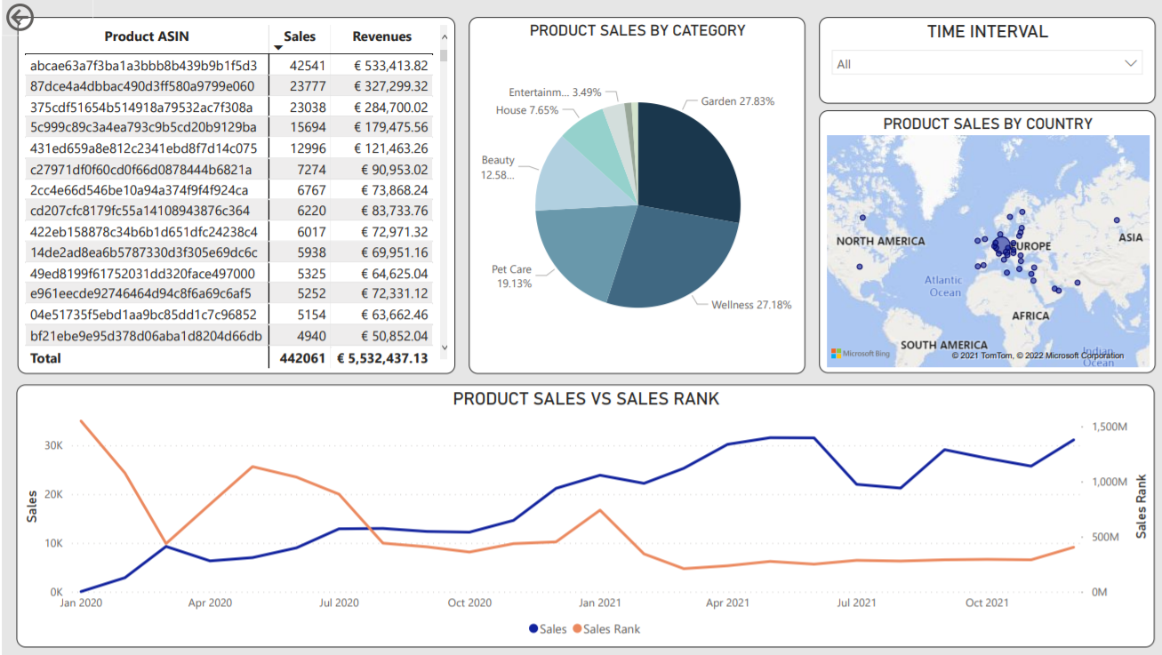
Data Analysis using Power BI Product Sales and Sales rank overview

Slide 9
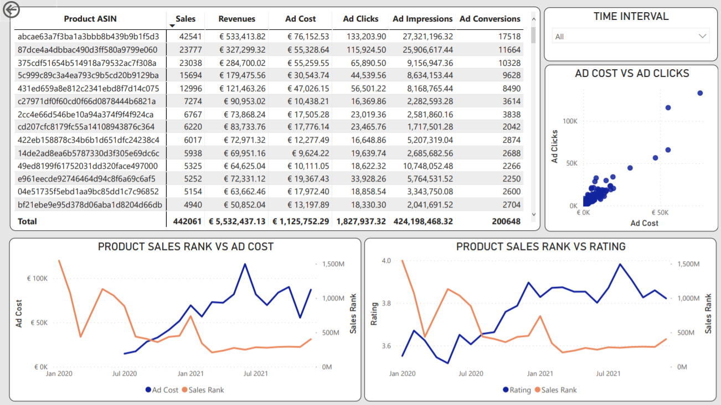
Data Analysis using Power BI Product Sales rank Vs Ad Cost and Rating

Slide 10
Hypothesis
From a first exploratory data analysis, it is observed that the success of a product (sales rank) might be influenced by the following features: rating, ad cost, and promotion discount.
Hence, the main hypothesis is that these features provide early signals for the success or failure of a product.

Slide 11
Data Preparation
In order to evaluate the hypothesis, Machine Learning techniques are implemented.
A dataframe containing: rating, ad cost, and promotion discount information for the available products is created and the target variable that will determine the success of a product is chosen to be the sales rank.
The data is cleaned and preprocessed for the modelling phase.

Slide 12
Modelling
In the modelling phase, two models are implemented:
Autoregressive Integrated Moving Average (ARIMA)
The ARIMA model is used to forecast the sales rank of each product for the last product-month by using the historical sales rank information of the corresponding product. This will be the “baseline” model to evaluate the main hypothesis.
Random Forest
The Random Forest model is used to predict the sales rank of each product for the last product-month by using the rating, ad cost, and promotion discount information of each product. This approach will help understanding if the chosen features play a role in determining the success or failure of a product.

Slide 13
Evaluation
For the ML evaluation step, the metric chosen the Mean Average Percentage Error (MAPE).
The MAPE is one of the most commonly used performance metrics to measure the accuracy of a forecasting problem.
MAPE is the sum of the individual absolute errors divided by the demand (each period separately). In other words, it is the average of the percentage errors.
MODEL | MAPE (AVG OF ALL PRODUCTS)
ARIMA | 77%
RANDOM FOREST | 44%

Slide 14
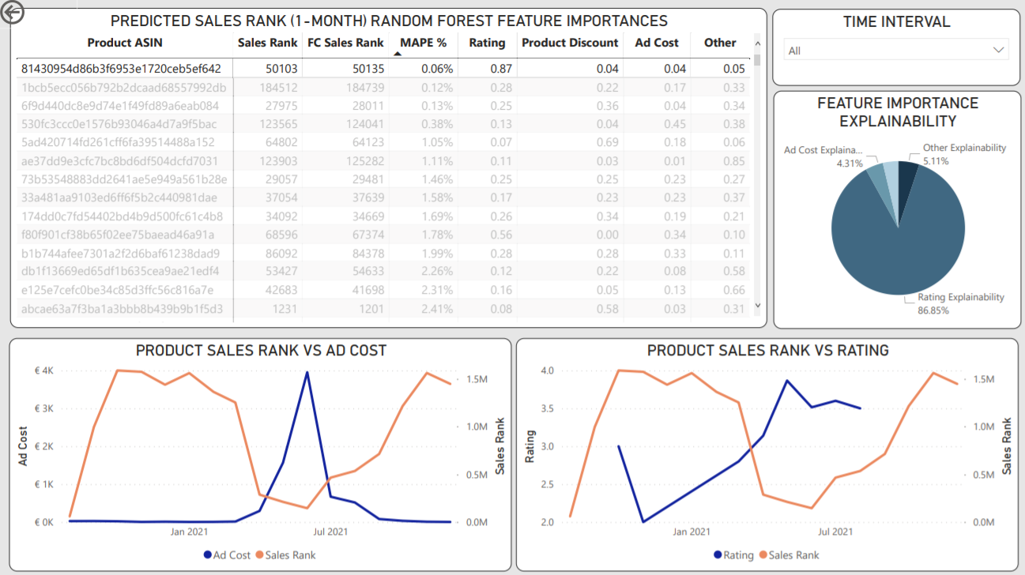
Evaluation using Power BI

Slide 15
Conclusion
From the EDA, it is observed that the success or failure of a product can be determined by some of the features contained in the data.
The key features appear to be: rating, ad cost, and promotion discount.
Machine Learning techniques were used to understand whether the derived hypothesis can be considered or not.
From the evaluation step, it can be proven that the above features contribute to the success or failure of a product, and can interpreted as early signals to identify products’ success or failure patterns.

Slide 16
Future Works
The stock dataset containing information on the availability of the products can be taken into consideration for further analysis. It can play a relevant role on the sales of a product.
Features such as ad clicks and ad impressions from the marketing table can also be further analysed.
Dense data instead of sparse data could add richness to the analysis and provide a clearer understanding of the contribution of each feature to determine the success or failure of a product.

Slide 17


